Slide 1
Quentin Chibaudel¹, Véronique Lespinet-Najib¹, Karima Durand², Laurence Piant³ and Frédéric Piant³
Evaluation of the remote control affordance of medicalized bed for people with mental disabilities getting older (PDO)
Equipe Cognitique & Ingénierie Humaine (CIH) – Laboratoire IMS (UMR CNRS 5218) / Ecole Nationale Supérieure de Cognitique (ENSC) – Bordeaux INP
2. Association pour le Développement et les Gestion des Équipements Sociaux, Médico—sociaux et sanitaire (ADGESSA)
3. Groupe de Conseil, Gestion et Prestation en Dispositifs Médicaux (CGPDM) – Médical Thiry
Thursday 28th of August

Slide 2
Context
Methodology
Results
Perspectives
Notes:
Presentation :
Context : defintiion of key elements and aim of the study
UbiSmart and AMICAs : tools studied
Results w got
What’s for the future ?

Slide 3
Context
Methodology
Results
Perspectives
Access to care in France
French system divided in two
In France (DREES, 2013) :
635 000 people with mental disabilities are more than 40 years old
267 000 people with mental disabilities are more than 60 years old
People getting older
People with mental disabilities
PDO
Notes:
To be remembered :
Hard to give definition
Global netword
System divided in sub systems
Exchange of information

Slide 4
Context
Methodology
Results
Perspectives
People with mental disorder getting orlder
People with mental disorder
People ageing
A person with mental disorder getting older is someone who lived with a disability (whatever the specific nature of the handicap or the cause) before facing the effects of ageing (Azéma & Martinez, 2005).
Aging phenomenum appears aroun 40 years old (CNSA, 2010).
50 years old is a critical gap for them (Makdessi, 2016).
→ One main issue : medical devices are not adapted to this population (Chibaudel & al, 2016)
Notes:
To be remembered :
Hard to give definition
Global netword
System divided in sub systems
Exchange of information

Slide 5
Context
Methodology
Results
Perspectives
Human Centered Design conception
« Human-centered Design is an approach to interactive systems development that aims to make systems usable and useful by focusing on the users, their needs and requirements, and by applying human fac- tors/ergonomics, usability knowledge, and techniques. This approach enhances effectiveness and efficiency, improves human well-being, user satisfaction, ac- cessibility and sustainability; and counteracts possible adverse effects of use on human health, safety and performance » (ISO, 2010)
One problem : some users (like frailty ones : people with disabilities, people aging, …) are not taken into account (Lespinet & al, 2017)
Notes:
To be remembered :
User in the center of the process
Adapt tools to the user’s needs
Not enought → some are forgotten

Slide 6
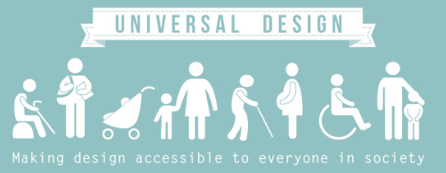
Context
Methodology
Results
Perspectives
Universal Design
« Design for all » (Burzagli & al, 2009)
« Barrier free environment » (Mathew & Aggarwal, 2012)
« Inclusive design » (Goodman-Deane & al, 2014)
If you can make a tool accessible for frailty people, it will be accessible for everyone (Gronier & al, 2014)
→ « he who can do more, can do less »
Notes:
Everything is on the diapositive

Slide 7
Context
Methodology
Results
Perspectives
Protocole based on ISO norm of usability
Norm ISO 9241 – 10 : « a product can be used by specified users to achieve specified goals with effectiveness (Task completion by users), efficiency (Task in time) and satisfaction (responded by user in term of experience) in a specified context of use (users, tasks, equipments & environments). »
Specified user : PDO
Context of use : in retirement homes
Goals to achieve : understand how they can adjust their bed
Notes:
Ubismart :
Based on IoT
Help elderly people in case of problem
Description of the tool
Introduction of the methodology

Slide 8
Context
Methodology
Results
Perspectives
Sample
Tests were realized in May 2017, in Nouvelle-Aquitaine, France
10 participants
2 retirement homes
Average age : 65 years old
Notes:
Description of the different grids

Slide 9
Context
Methodology
Results
Perspectives
Results obtained
Norm ISO 9241 – 10 : « a product can be used by specified users to achieve specified goals with effectiveness (Task completion by users), efficiency (Task in time) and satisfaction (responded by user in term of experience) in a specified context of use (users, tasks, equipments & environments). »
They cannot use the remote control alone, they need help
→ Poor efficiency
They feel frustrated when they cannot use it alone
→ Poor satisfaction
They cannot adjust their bed as they want
→ Poor efficiveness
→ Remote control is not usable.
Affordance of the remote control must be improved
Notes:
Description of the different grids

Slide 10
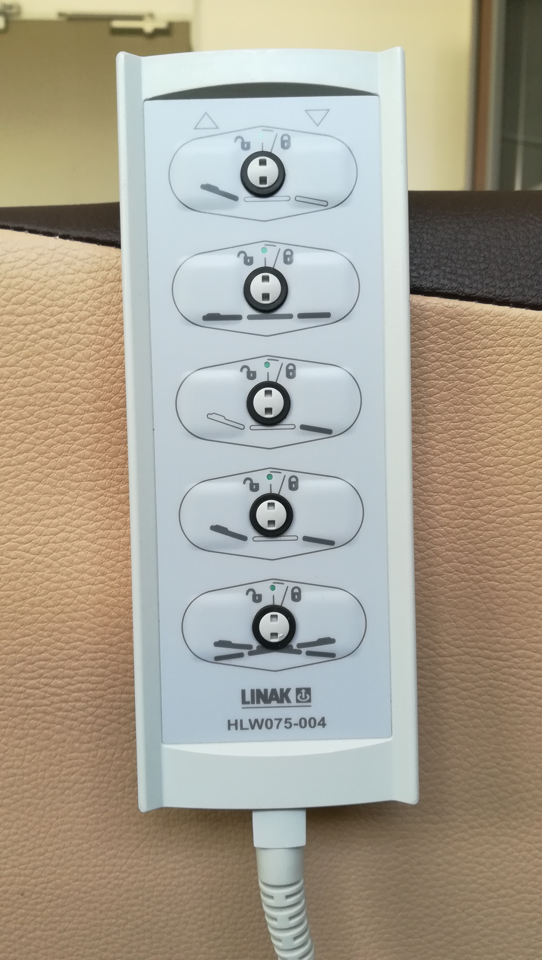
Context
Methodology
Results
Perspectives
Recommandations
First recommandation : improve the ergonomics of the remote control
Hard to see the arows
Hard to understand you can press on the button
Adaptability : the tool should adapt itself to the context (Bastien et Scapin, 2001; Schneiderman, 2010)
colors, constrast, relief, brail
Picture of the current remote control
Notes:
Some work still need to be done

Slide 11
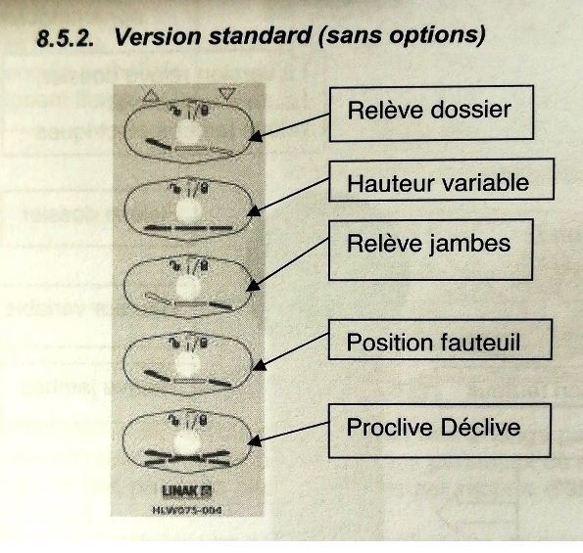
Context
Methodology
Results
Perspectives
Recommandations
Second recommandation : improve the ergonomics of the user manual
« variable height » :
→ what height is variable ?
« trendelenburd » and « reverse-trendelenburg »
→ do you know what that means ?
Guidance : lexical caracteristics to present the information must be simple (Bastien et Scapin, 2001; Schneiderman, 2010)
Simplify lexical vocabulary
Picture of the current user manual (in French)
Notes:
Some work still need to be done

Slide 12
Context
Methodology
Results
Perspectives
For the futur
Interest of the universel design approach
Notes:
Some work still need to be done

Slide 13
Context
Methodology
Results
Perspectives
Azéma, B., & Martinez, N. (2005). Les personnes handicapées vieillissantes: espérances de vie et de santé; qualité de vie. Revue française des affaires sociales, (2), 295-333.
Bastien, J. M. C., & Scapin, D. L. (2001). Évaluation des systèmes d'information et Critères Ergonomiques. Environnements évolués et évaluation de l’IHM, Interaction homme-machine pour les SI, 2, 53-80.
Burzagli, L., Emiliani, P. L., & Gabbanini, F. (2009). Design for All in action: An example of analysis and implementation. Expert Systems with Applications, 36(2), 985–994.
Chibaudel, Q., Lespinet-Najib, V., Durand, K., Piant, L., Piant, F. (2016) Access to care for people with mental disabilities getting older through the study of the accessibility to medical devices: the situation in France. Proceedings of Healthcare Systems Ergonomics and Patient Safety (HEPS). Toulouse, 2016.
DIS, I. (2009). 9241-210: 2010. Ergonomics of human system interaction-Part 210: Human-centred design for interactive systems. International Standardization Organization (ISO). Switzerland
DREES (2013). L’enquête auprès des établissements et services pour enfants et adultes handicapées.
Goodman-Deane, J., Ward, J., Hosking, I., & Clarkson, P. J. (2014). A comparison of methods currently used in inclusive design. Applied Ergonomics, 45(4), 886–94.
Gronier, G., Tissier, I., Reiter, S., & Valoggia, P. (2014). La Conception pour Tous appliquée aux Interactions Homme-Machine: démarche méthodologique et retour d'expérience. SELF, 1.
Lespinet-Najib, V., Roche, A., & Chibaudel, Q. (2017). Santé et handicap: d’une conception centrée «utilisateur» à la conception universelle. In Annales des Mines-Réalités industrielles (No. 2, pp. 25-27). FFE.
Makdessi, Y., Ravaud, J. F., & Vanderschelden, M. (2016). Profils d’autonomie et de dépendance (s) des résidents en établissement médico-social. Approche multidimensionnelle–Enquête Handicap-Santé–volet Institutions (HSI 2009). Revue française des affaires sociales, (4), 157-191.
Mathew, S., & Aggarwal, A. (2012). Barrier free environment for inclusive education of children with hearing impairment at secondary level. Golden Research Thoughts, 2(5), 1.
Schneiderman, B. (2010). Designing the user interface: strategies for effective human-computer interaction. Pearson Education India.

Slide 14
Context
Methodology
Results
Perspectives
Thanks for your attention
Équipe Cognitique et Ingénierie Humaine
Laboratoire IMS – UMR CNRS 5218
&
École Nationale Supérieure de Cognitique
Bordeaux INP
&
ADGESSA
&
Groupe CGPDM – Médical Thiry
Quentin Chibaudel
quentin.chibaudel@ensc.fr

